Slide 1
PharmAssist
A prescription for savings

Slide 2




Meet the Team
Isha Cheema
Alea Nablan
Larissa Franco
Sauda Shamiha
Psychology Major
Computer Science Major
Computer Science Major
Computer Science Major

Slide 3
What’s the problem?
Rising drug
prices
Conflicting information
Unknown
Medication costs
Drug Misuse
70% of Americans are on at least one prescription drugs
Lack of transparency

Slide 4
Me too drug?
Drug companies “chemically rejigger an oldie but goodie, craft a new name, mount a massive advertising campaign and sell the retread as the latest innovative breakthrough” (LaMattina).
NexIUM vs. Prilosec ($411 compared to $15)

Slide 5
Solution?

Slide 6
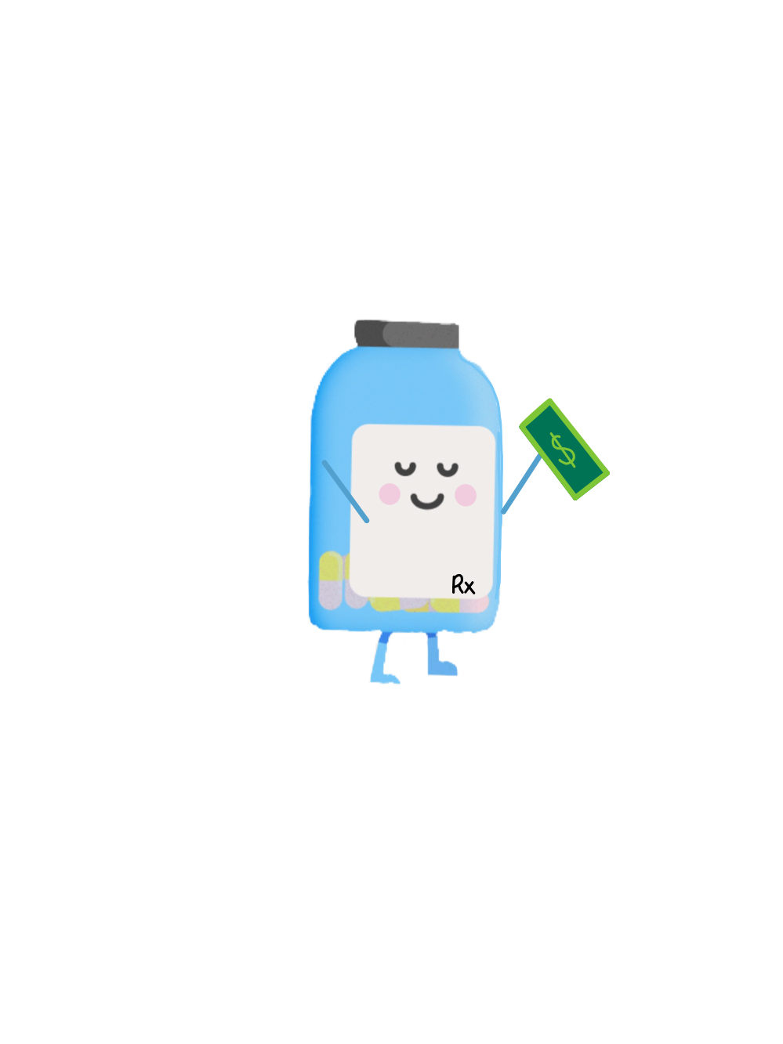
PharmAssist
A prescription for savings

Slide 7
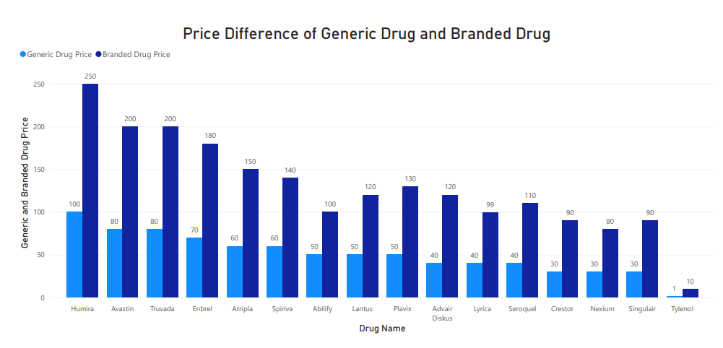

Slide 8
What does it do?
Compares prices of Brand-name drugs to generic versions
Allows for more transparency
Summarizes information in an easy way
Allows for easy access to medications
Filters through selective categories
Increases patient knowledge
Notes:
1st - on the market theres currently 91 percent of brand name drugs that have a generic substitute, so users can save 80-85 percent more on generic versions
2nd - for people that dont hav any medical knowledge
3rd - EX: allergies, preferred method of consumption
4th - which doesn’t withhold any information, such as 100 percent of generic drugs meeting same FDA standard as brand drugs
5th - which bridges the gap between pharmaceutical companies and patients
6th - lastly, it increases patient knowledge

Slide 9
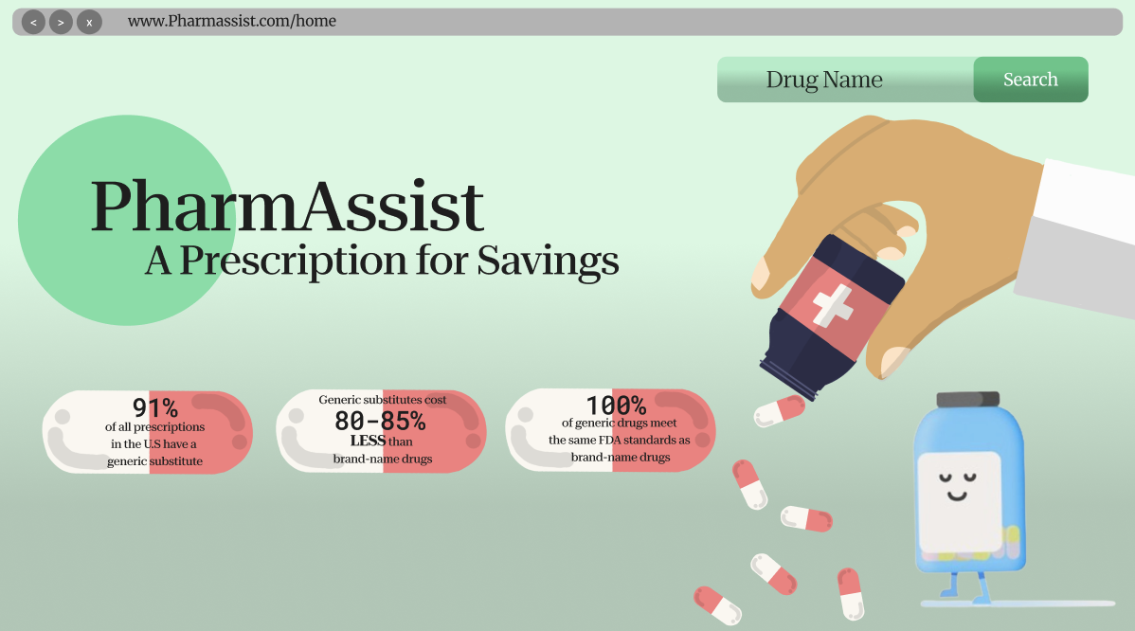
Notes:
Simple format so that it is easy to look through for the user, and they’re not overwhelmed with information on the initial screen
We also have included the most important stats on this page, so that users are aware of the issues at hand

Slide 10
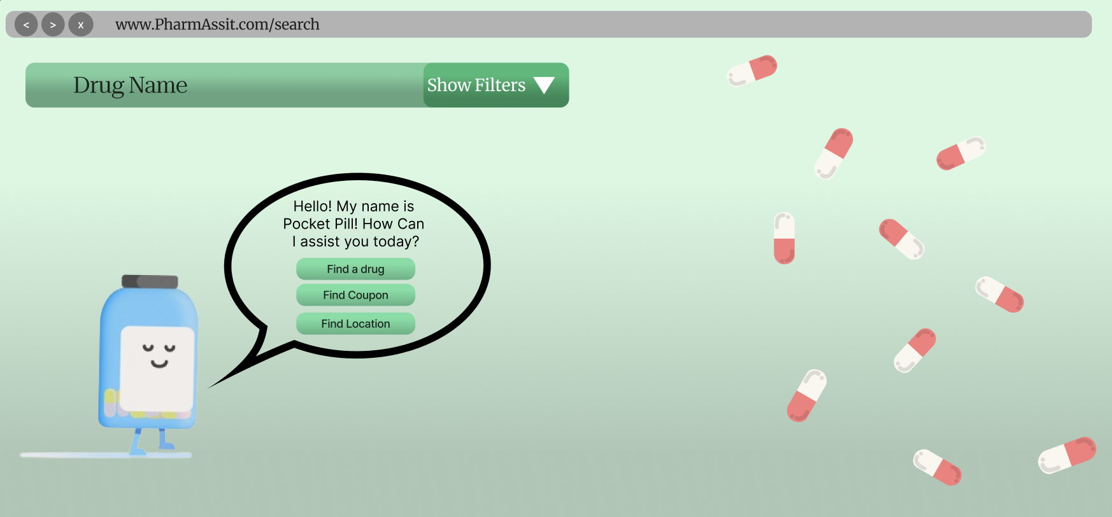
Notes:
Alea
As another way to access information
So the user will see our little mascot pocket pill who will ask frequent questions and point them in the right direction of our web application

Slide 11
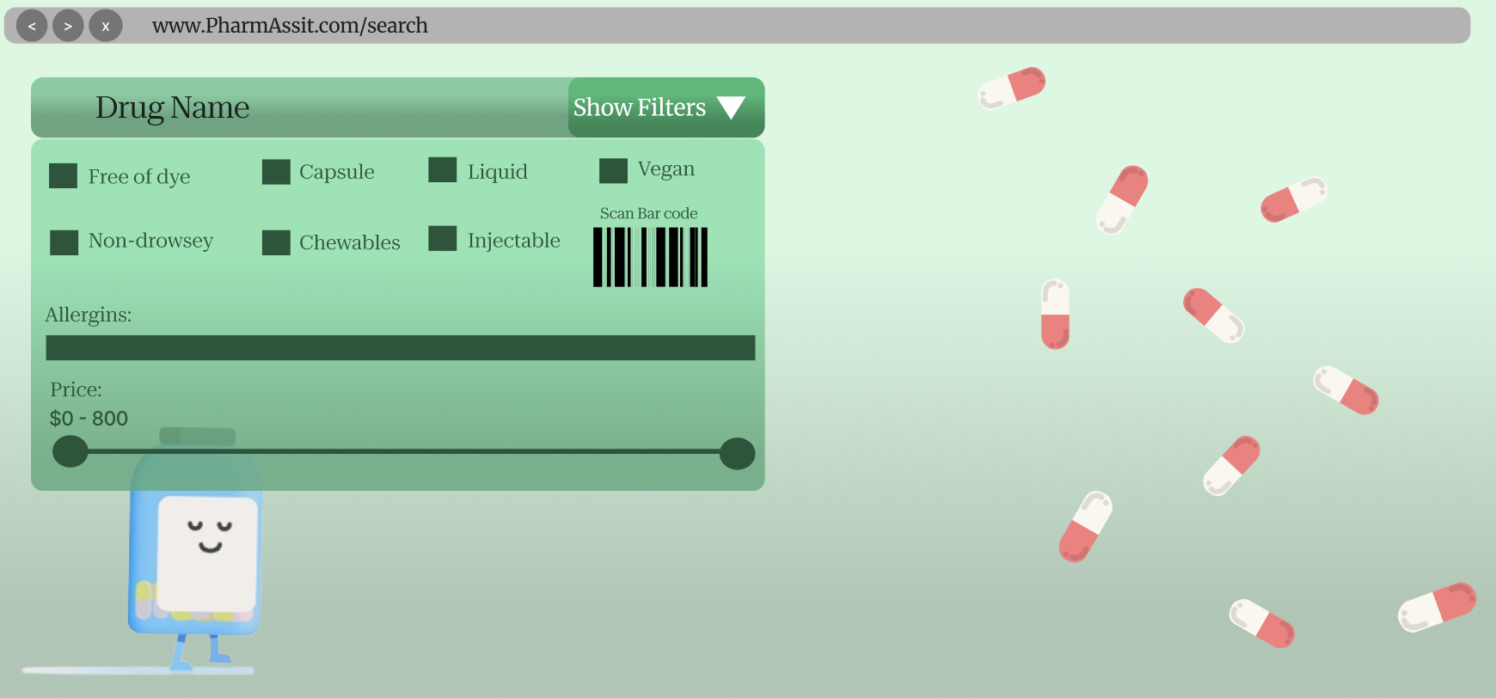
Notes:
Alea
When searching for the drugs, another feature we wanted was for users to be able to filter based on their needs such as any kind of allergies they may want to avoid, price range and the type of drug such as if they are chewable, capsule, liquid, etc.

Slide 12
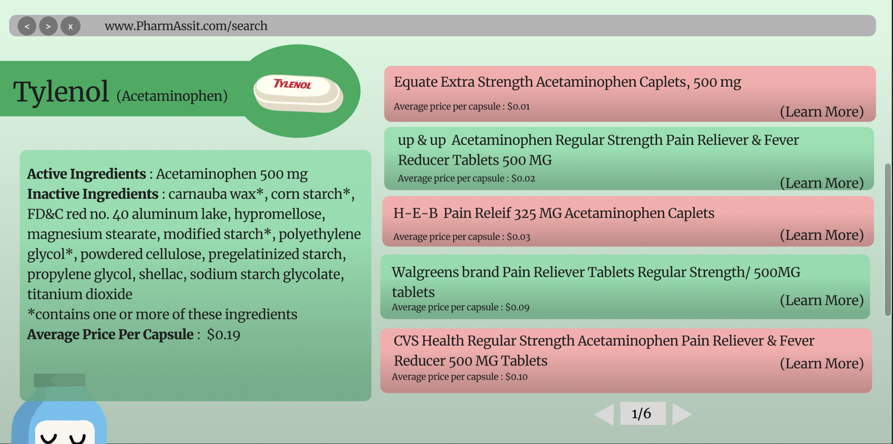

Slide 13
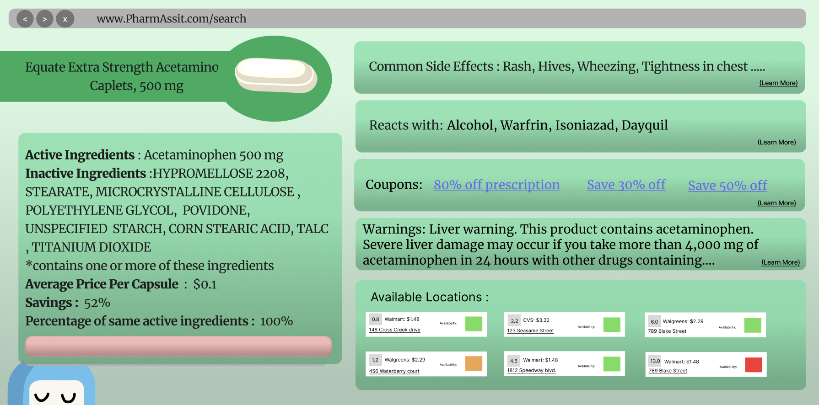

Slide 14
Our Solution
01
02
03
Makes healthcare more accessible
Increases transparency between pharmaceutical companies and patients
Simple & Effective

Slide 15

Demo
Notes:
alea

Slide 16
Questions?

